Slide 1
PIXELATED IMAGE DETECTION AND CORRECTION
Team: The Deciders
Harsine K U
Dhivyasubashini K
Lakshya S
Kongu Engineering College, Erode- 638060

Slide 2
Problem Statement
Detect Pixelated Image and Correct It
Develop lightweight algorithms to detect pixelated images with more accuracy, minimizing false positives.
Create efficient methods to enhance image quality by restoring pixelated images, operating at a minimum of 20 FPS on 1080p resolution.
Evaluate using metrics like LPIPS and PSNR, and deliver detailed reports with implementation code.

Slide 3
Unique Idea Brief (Solution)
Detection: Incorporating convolutional neural network (CNN) to classify whether an image is pixelated or not.
Correction: Enhanced Super-Resolution Generative Adversarial Networks(ESRGAN) technique to enhance the quality of pixelated image.

Slide 4
Features Offered
Texture Analysis
Blockiness Detection
PSNR-based Detection
Image Enhancement using TensorFlow
Image directory setup
Data Preprocessing
Data Augmentation
Edge Sharpness

Slide 5
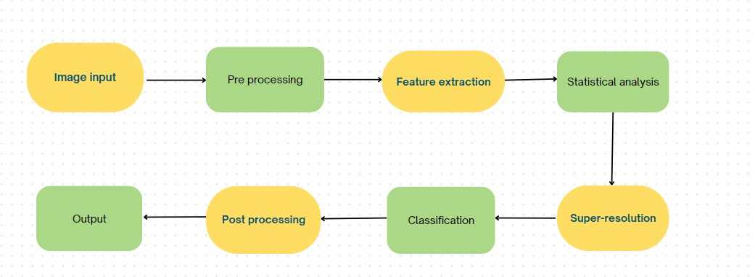
Process flow

Slide 6
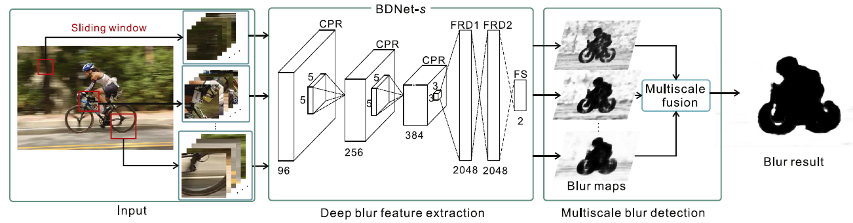
System Architecture
CNN Architecture for Detection

Slide 7
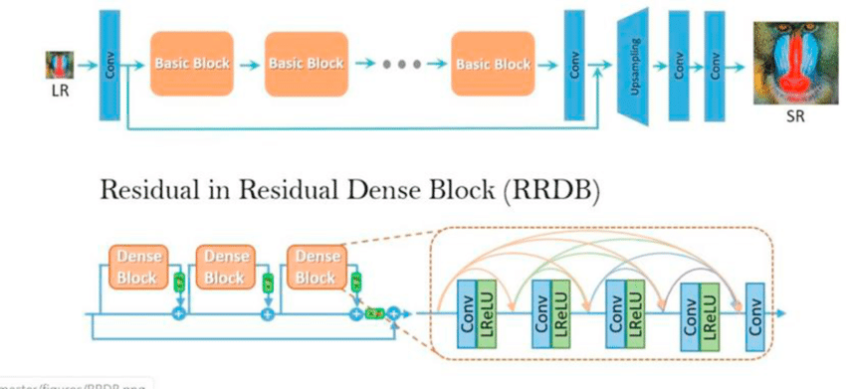
System Architecture
ESRGAN Architecture for Correction

Slide 8
Technologies used
Convolutional Neural Network (CNN)
Enhanced Super-Resolution Generative Adversarial Networks(ESRGAN)
Edge Detection Algorithms
Python for model development
TensorFlow/PyTorch for deep learning
OpenCV for image processing
NumPy for numerical operations
Peak Signal-to-Noise Ratio (PSNR)

Slide 9
Team members and Contribution
Team member 1: Harsine K U
Pipeline development, detection of pixelated images
Team member 2: Dhivyasubashini K
Data collection & Preprocessing, evaluation and documentation
Team member 3: Lakshya S
Integrating the models, correction of pixelated images

Slide 10
Conclusion
This project successfully develops a pipeline for detecting pixelated images
using convolutional neural networks (CNN) and traditional image processing
techniques.
The CNN model effectively extracts features and distinguishes pixelated from non-pixelated images with high accuracy.
Regularization techniques like dropout layers, L2 regularization, and early stopping prevent overfitting and ensure generalization.
A complementary Peak Signal-to-Noise Ratio (PSNR) method is also incorporated.
Preparation steps for image enhancement using TensorFlow Hub extend the project's applicability, setting a foundation for future improvements. advancements.

Slide 11
Thank you

